Slide 1

Comprehensive Digital Marketing
Project Work

Slide 2

Part 1: Brand study, Competitor Analysis & Buyer’s/Audience’s Persona
Research Brand Identity: Study the brand's mission, values, vision, and unique selling propositions (USPs).
Company for project: PARLE AGRO
Logo:
Mission/Values:"Parle Agro is focused on charming purchasers by giving top caliber, creative, and reviving food and drink items. We endeavor to make a positive effect on society, and our main goal is to turn into a main player in the business while guaranteeing economical development and dependable strategic policies."
USP :Shifted Item Portfolio: Parle Agro offers a great many items, including organic product based drinks like Froth, Apply, Apply Bubble, Bailey, and bundled snacks like Hippo. This assorted portfolio permits the organization to take special care of different customer inclinations and socioeconomics.

Slide 3
Part 1: Brand study, Competitor Analysis & Buyer’s/Audience’s Persona
Analyse Brand Messaging:Accentuation on Regular and Genuine Natural product Fixings: Parle Argo's image informing has reliably featured the utilization of genuine organic product fixings in their refreshments, particularly in items like Froth and Apply. This informing is pointed toward engaging wellbeing cognizant customers who favor normal and bona fide flavors in their beverages.
Invigorating and Pleasant Experience: Parle Agro frequently centers around the reviving and charming experience of consuming their items. The brand informing passes on a feeling of tomfoolery, happiness, and unwinding, situating their drinks as reviving allies for different events.
Young and Enthusiastic Energy: The brand informing of Parle Agro items, especially Froth and Apply, has an energetic and lively energy. They focus on a wide age bunch, with a unique enticement for the more youthful age, making their refreshments a piece of a lively and dynamic way of life.

Slide 4
Examine the brand's tagline: Appeal to Feeling: "Hunger for More" takes advantage of purchasers' personal longings for fulfillment and happiness. It infers that Parle Argo's drinks are so invigorating and great that they leave individuals needing one more taste or significantly more jugs of their items. Source of inspiration: The slogan fills in as an unobtrusive source of inspiration, empowering purchasers to extinguish their thirst with Parle Argo's drinks and fulfill their desires for a reviving encounter. Optimistic: The slogan recommends that consuming Parle Argo's drinks goes past simple revitalizing; it makes an optimistic encounter where purchasers look for a greater amount of the wonderful taste and reward.

Slide 5
Part 1: Brand study, Competitor Analysis & Buyer’s/Audience’s Persona
Competitor Analysis: Select three competitors operating in the same industry or niche as the chosen brand, examine their USPs and online communication.
Competitor 1 : https://www.parleproducts.com/
USP :All round sales, wide variety of products ,categorisation.
Communication : user generated content ,lots of tutorials ,values.
Competitor 2 : https://www.parleagro.com/
USP : Diverse port , Refreshing and fun.
Communication : Supply at world wide.
Competitor 3 : https://www.parleagro.com/brand/
USP : Natural fruit -Based Beverages. Innovative packaging.
Communication : Using digital marketing.

Slide 6
Part 1: Brand study, Competitor Analysis & Buyer’s/Audience’s Persona
Buyer's/Audience's Persona: Clearly define the target audience for the chosen brand. Consider demographics, psychographics, behaviours, and interests.
Socioeconomics:
Age: 25 to 35 years of age
Orientation: Prevalently female, yet in addition incorporates guys
Area: Essentially metropolitan regions in India
Schooling: School instructed, with a blend of graduates and postgraduates
Pay: Center to upper-working class
Psychographics:
Way of life: Riau is a bustling youthful expert, adjusting work and individual life. She is socially dynamic and appreciates investing energy with loved ones during ends of the week and unique events.
Wellbeing Cognizant: Riau is wellbeing cognizant and looks for items that offer normal fixings and better other options. She lean towards drinks that are liberated from fake flavors and additives.

Slide 7
DEMOGRAPHIC:
Age: Parle Agro's items like Frooti and Appy are famous among a wide age range, yet they are particularly well known among kids, teens, and youthful grown-ups because of their reviving and fun nature.
Orientation: The items presented by Parle Agro are ordinarily delighted in by the two guys and females, making them a gender neutral brand.
Metropolitan versus Country: Parle Agro's items are generally accessible and have a wide allure in both metropolitan and provincial regions.
Pay Level: Parle Agro's items are situated at different price tags, making them open to shoppers with various pay levels.
Way of life and Inclinations: Shoppers who are wellbeing cognizant may pick Parle Agro's organic product based refreshments, while others might pick their items for their taste and accommodation.

Slide 8
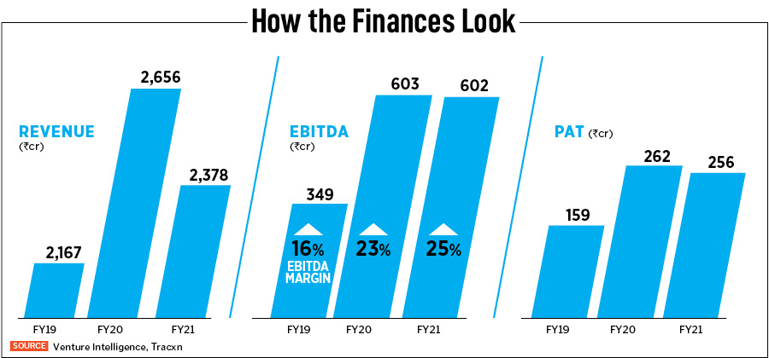
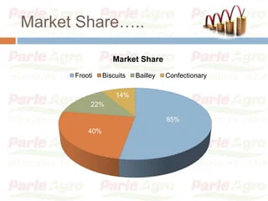
Demographic:

Slide 9
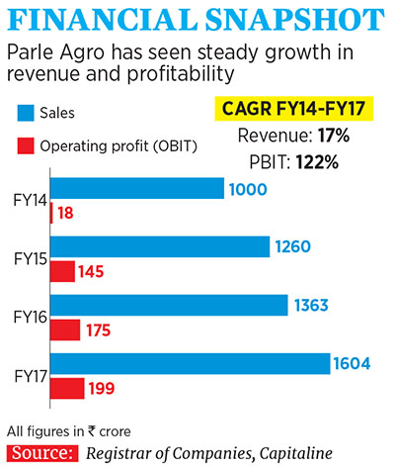
Psychographic:
Energetic and Carefree: Parle Agro's items like Frooti and Appy are known for their lively and young picture, interesting to buyers who appreciate fun and bold encounters.
Wellbeing Cognizant: A few purchasers might pick Parle Agro's items since they are organic product based and saw as better options in contrast to carbonated drinks.
Taste-Arranged: Shoppers who focus on taste and flavor may be drawn to Parle

Slide 10
Part 2: SEO & Keyword Research
SEO Audit: Do an SEO audit of the brands website
Keyword Research: Define Research Objectives, Brainstorm Seed Keywords, Utilize Keyword Research Tools (SEMrush or Moz Keyword Explorer),Analyze Competitor Keywords, Long-tail Keyword Exploration (specific, longer phrases) that align with the research objectives and have lower competition but higher conversion potential.
On page Optimization: Meta Tag optimization & content optimization
Reflect on the process of conducting keyword research and the SEO recommendations provided.
Document the challenges faced during the research and analysis phase, as well as the key insights gained from the keyword research process.

Slide 11

SEARCH ENGINE OBJECT:
Search engine optimization is the process of improving the quality and quantity of website traffic to a website or a web page from search engines. SEO targets unpaid traffic rather than direct traffic or paid traffic these is the process used the Parle Agro company.
It will helps to find the searching content on Parle Agro.

Slide 12
KEYWORD RESEARCH: Distinguish applicable catchphrases connected with Parle Agro's items and ideal interest group. Find high-esteem watchwords with huge inquiry volumes and change potential. Reveal long-tail catchphrases that line up with the organization's contributions and have lower rivalry. Conceptualize Seed Watchwords: Begin by conceptualizing general seed watchwords that are straightforwardly connected with Parle Agro's items and brand. Models include: Organic product based drinks Frooti Appy Parle Agro Reviving beverages Solid drinks Juice drinks

Slide 13
OPAGE OPTIMIZATION:
On-page smoothing out for Parle Agro includes advancing the site to upgrade client experience, further develop web search tool perceivability, and drive changes. Here are a vital stages to accomplish on-page smoothing out:
Web optimization Review: Direct a thorough Website design enhancement review of the site to distinguish regions that need improvement. Break down the site structure, content, meta labels, URLs, and generally Search engine optimization wellbeing.
Catchphrase Enhancement: Use the watchword research results to advance on-page content. Integrate significant watchwords normally into page titles, headings, meta depictions, and all through the substance.
Clear Route: Guarantee that the site has a reasonable and natural route structure. Clients ought to have the option to handily find the data they are searching for without disarray.
Portable Responsiveness: Ensure the site is completely responsive and dynamic. A huge piece of clients access the web through cell phones, so the site should give an incredible portable encounter.
Page Speed Advancement: Upgrade the site's stacking speed by packing pictures, utilizing reserving, and minifying CSS and JavaScript. A quick stacking site improves client experience and Web optimization execution.
Easy to understand URLs: Make easy to use and spellbinding URLs that incorporate significant catchphrases. Abstain from utilizing extensive, confounding series of numbers and images.
Convincing Meta Depictions: Compose convincing and significant meta portrayals for each page. These short scraps show up in web crawler results and can fundamentally affect navigate rates

Slide 14
Part 3: Content Ideas and Marketing Strategies
Content Idea Generation & Strategy: Create a content calendar for the remaining month of July by brainstorming content themes, exploring various formats like blog posts, videos, infographics, podcasts, and interactive quizzes, and scheduling publication dates mainly on Facebook & Instagram. And include the strategy, aim and the idea behind these posts and story
Content Calendar Example (Try creating a table for the month of July)

Slide 15
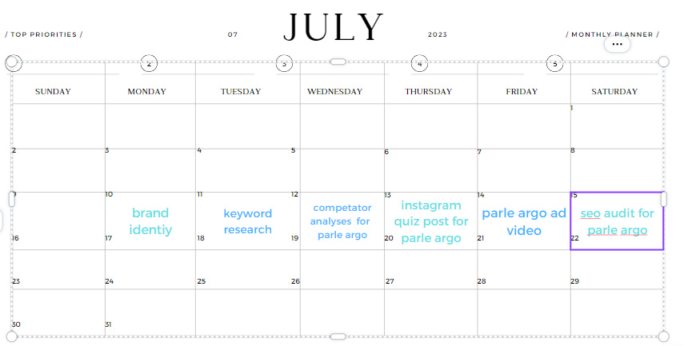
Part 3: Content Ideas and Marketing Strategies
Content Idea Generation & Strategy:

Slide 16

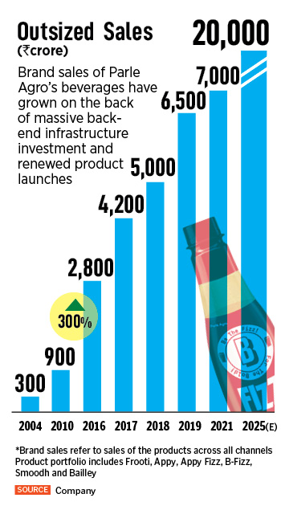

Slide 17
Frooti: Frooti is one of the most renowned results of Parle Agro. It is a mango-seasoned drink and a famous decision among shoppers, particularly during the warm mid year months.
Appy Bubble: Appy Bubble is a carbonated squeezed apple drink that has acquired critical fame as an option in contrast to conventional soda pops.
Appy: This is one more organic product juice item presented by Parle Agro, accessible in different natural product flavors like orange, pineapple, and apple.
Bailey: Bailey is a non-alcoholic malt-based refreshment presented by Parle Agro.
Frio: Frio is a scope of bundled drinking water items.
Bailley Pop: Bailley Soft drink is a carbonated water brand from Parle Agro.

Slide 18
Part 3: Content Ideas and Marketing Strategies
Reflect on the content ideas and marketing strategies process, discussing the challenges encountered and lessons learned.
Grasping Customer Conduct: One of the essential difficulties in advertising is appreciating the consistently changing buyer conduct and inclinations. Shoppers are affected by different elements like patterns, culture, and innovative progressions. Acquiring bits of knowledge into their necessities and inspirations requires constant examination and information investigation.
Serious Contest: In many ventures, rivalry is wild, and hanging out in a jam-packed market can be troublesome. Fostering a remarkable incentive and separating from contenders is fundamental, yet it requires inventiveness and a profound comprehension of the market.
Spending plan Imperatives: Assigning showcasing spending plans productively can be testing, particularly for more modest organizations. Adjusting between various showcasing channels and missions while guaranteeing areas of strength for an on venture (return for money invested) is a fragile undertaking.

Slide 19
Illustrations Gained from Advertising Procedures and Difficulties: Shopper Driven Approach: Putting the purchaser at the focal point of showcasing endeavors is significant. Understanding their requirements, problem areas, and goals makes significant and convincing showcasing messages. Nonstop Exploration and Examination: Remaining refreshed with market patterns and customer bits of knowledge through consistent exploration and information investigation is fundamental for pursuing informed choices. Dexterity and Versatility: The showcasing scene is dynamic, and procedures should be versatile to evolving conditions. Adaptability permits organizations to answer rapidly to new open doors or difficulties. Mix and Consistency: A coordinated promoting approach guarantees consistency in informing across different channels. A strong brand picture assists work with trusting and acknowledgment among buyers.

Slide 20
Part 4: Content Creation and Curation (Post creations, Designs/Video Editing, Ad Campaigns over Social Media and Email Ideation and Creation)
Post Creation:
CREATION POSTS
Format 1
https://parleagrosupport.blogspot.com/2023/07/parle-agro-have-wide-business-goals-and.html
AIM: Parle Agro have wide business goals and missions that guide their tasks and development. While I can't give the exact statement of purpose, I can provide you with a general comprehension of the points of organizations like Parle Agro in view of their business exercises:
DATE: 21/07/2023
IDEA: The center thought behind Parle Agro's business is to give reviving and inventive refreshments that take care of shoppers' fluctuating preferences and inclinations.
TOPIC: Parle Agro: Journey, Products, and Impact on the Beverage Industry
Format 2: We have created a information video about parle agro products.We have created on 21/07/2023.
Format 3: We have created an information memes on parle agro on 21/07/2023.

Slide 21
Part 4: Content Creation and Curation (Post creations, Designs/Video Editing, Ad Campaigns over Social Media and Email Ideation and Creation)
Instagram Story
Utilize the Stories feature on Instagram for three consecutive days. Share behind-the-scenes glimpses, polls, quizzes, or sneak peeks etc to encourage audience participation. Once uploaded use the story highlight feature on Instagram and save the 3 story with an appropriate name for each. Note: Once done monitor the performance of the posts and Stories using the insight tool and analyze the engagement metrics (likes, comments, shares, impressions, etc.). Based on the analysis, mention the strategies and areas for improvement.
INSTAGRAM STORY: We have created three instagram stories on parle agro and screenshorts and provided below.

Slide 22
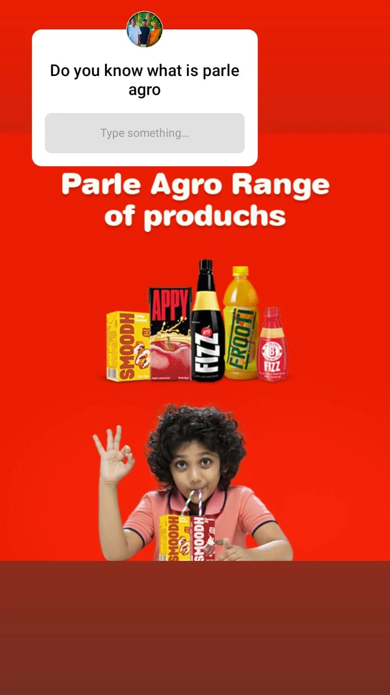
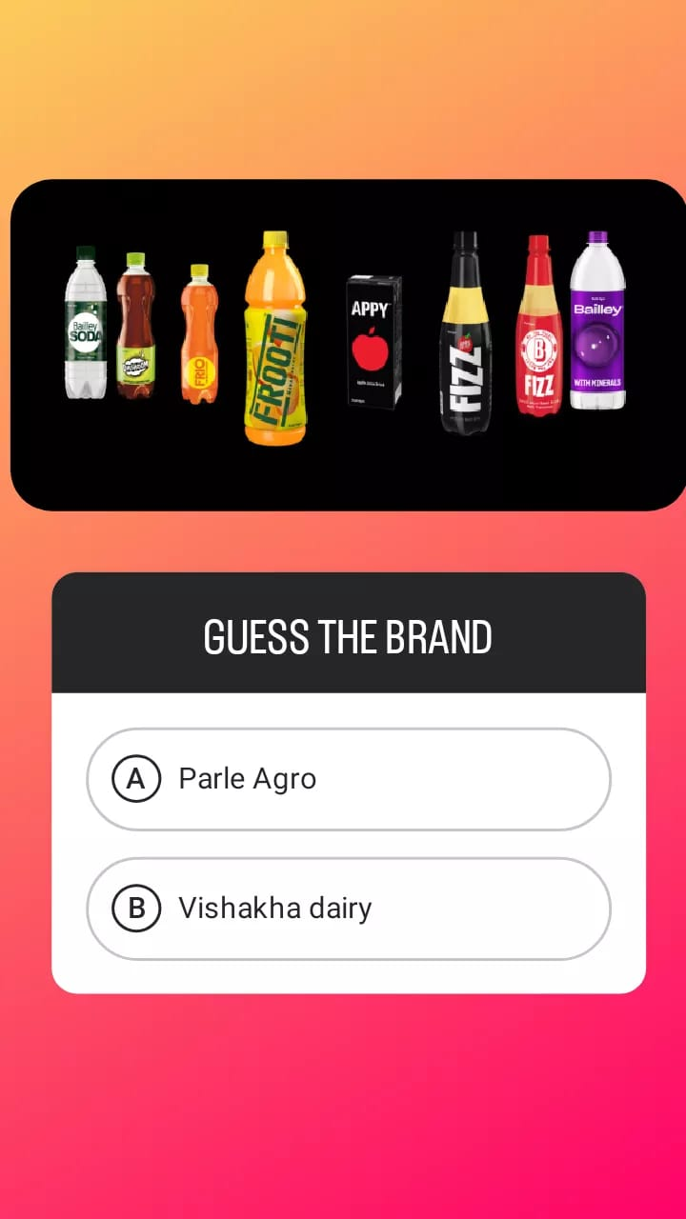
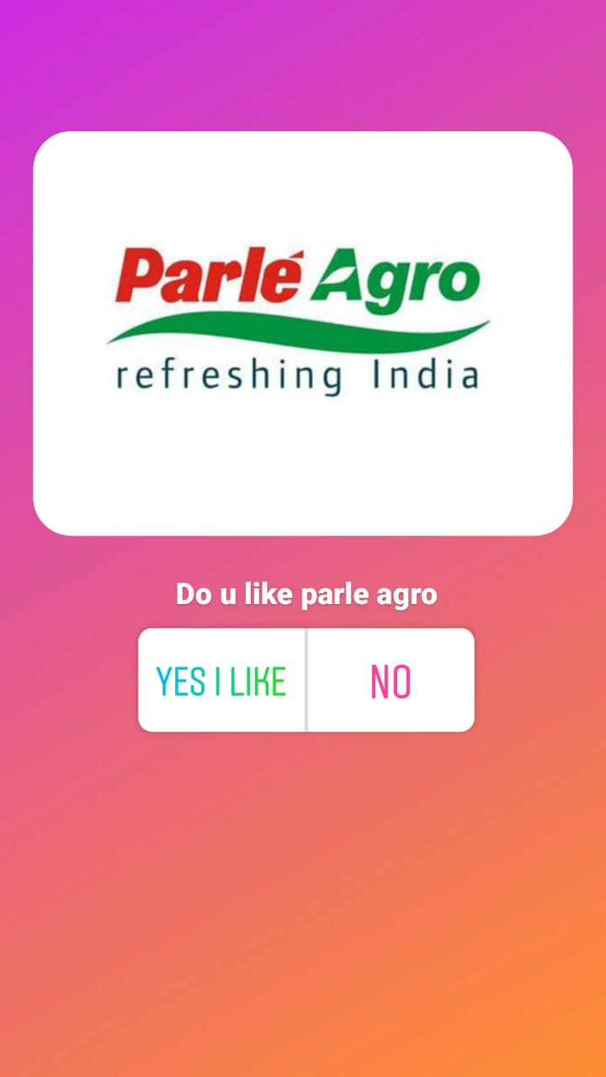
Instagram Story

Slide 23
Part 4: Content Creation and Curation (Post creations, Designs/Video Editing, Ad Campaigns over Social Media and Email Ideation and Creation)
Designs/Video Editing
Design Tools Familiarization (use Canva for creating visually appealing graphics)
Video Creation: Utilize VN or any video editor of your choice to create videos related to the chosen topic.
URL Link: https://www.canva.com/design/DAFpVWC_9XQ/weAjn0V5biE-Mvr3qsJhwQ/watch?utm_content=DAFpVWC_9XQ&utm_campaign=designshare&utm_medium=link&utm_source=publishsharelink

Slide 24





Social Media AdCampaigns:
Ad Campaigns over Social Media:
Come up with 3 ad campaigns each covering one of the mentioned goals: brand awareness, driving website tra c, or generating leads
Brand Awareness Campaign Name : Parle Agro

Slide 25
Parle Argo Mainly Dependson Brand Equality:
Brand Equality
Brand Equality is the value built -up in a brand . It is measured based on how a customer is aware of the brand. The value of a company's brand equality can be calculated by comparing the expected future revenue from the branded products with the expected future revenue from an equivalent non-branded product . This is the best calculation in approximately.
Brand Equality comprises of
Brand Awareness
Brand Loyalty 3)Brand Association
Brand Awareness
creating public awareness of a speci c brand in order to maximize itsrecognition, successful brand awareness strategies should de ne a company's uniquenessand set it apart from competitors. Quite simply, if potential customers do not know about acompany, they will not purchase from it. Therefore, one of the preeminent goals of any business should be to build brand awareness, albeit in as cost-e ective manner as possible.

Slide 26

Company Profile
Parle Agro is a company that has always believed in Innovation, Quality andTaste. It has launched fantastic product that have been extremely successful across thecountry. Their brands Frooti, Appy, N-joi, Appy Fizz and Bailley are leaders in their categories and are household names in India.They have always been a pioneer in whatever they have done.
PARLE AGRO BUSINESS STATEMENT
We are in the business of refreshing India with our products, refreshing the marketwith new categories and refreshing ourselves through innovation.
Brands are under Parle Agro
Parle Agro is the best Indian liquor guest. Our substance display or take public demonstrating new classi cations, construction brands and seizing retail share inside those classi cations.
We are passionate about developing our own brands, such as Frooti, Appy, Appy Fizz, BFizz, SMOODH, Bailley, Bailley Soda, Dhishoom and Frio. We enjoy creating and nurturing what we create.

Slide 27
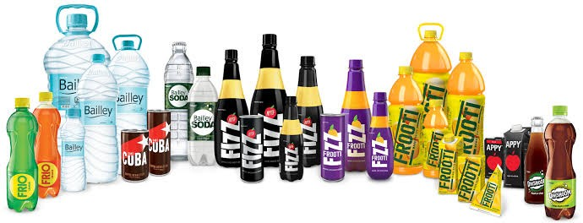
We enjoy creating and nurturing what we create
Brands Are Under Parle Agro

Slide 28
Part 4: Content Creation and Curation (Post creations, Designs/Video Editing, Ad Campaigns over Social Media and Email Ideation and Creation)
For every campaign clearly define:
Advertising Goals: increasing brand awareness, driving website traffic, or generating leads.
Audience Targeting: Define the target audience for the ad campaigns based on demographics, interests, and behavior.
Ad Creation: Create visually appealing ad creatives, compelling ad copy and relevant call-to-action.

Slide 29

Part 4content Creation and Curation (Post creations, Designs/Video Editing, Ad Campaigns over : CSocial Media and Email Ideation and Creation)
Email Ad Campaigns
Content Creation of parle argo:The well-known Indian beverage manufacturer "Parle Agro" is well recognized for creating well-liked brands like Frooti, Appy, Appy Fizz, and Bailley. Here are some suggestions for content development if you want to create something about Parle Agro or their products:Review the numerous beverages offered by Parle Agro in writing or on video. Discuss the items' flavor, packaging, and overall consumption experience. To assist customers in making wise decisions, compare various tastes and varieties.Produce information that explores the background and development of Parle Agro as a business. Highlight their development, significant moments, and how they rose to prominence in the beverage business.Behind-the-Scenes: Give viewers a look at the production process and behind-the-scenes video of Parle Agro's beverage production.

Slide 30

Content curation of parle argo:
At the time of my most recent update in September 2021, there was no particular item or piece of content with the name "Parle Argo." However, if "Parle Argo" has gained popularity since my previous update, I can still provide you a broad guide to content curation for a product or brand that can be useful to you.Gathering, arranging, and presenting pertinent and quality content from numerous sources about a specific subject, brand, or product is known as content curation. An instruction manual for selecting material for "Parle Argo" or a comparable product is provided below:Establish Your Audience Recognize who your target market is. Do they want to buy snacks? Are they foodies or something else? Knowing your audience will help you.

Slide 31

Email Ad Campaign 1
Brand Awareness:
an effective marketing tool to increase brand awareness. Here are some ways email ad campaigns can contribute to brand awareness:
Reach: Email campaigns allow companies to reach a large audience directly in their inboxes,
making it easier to spread brand messaging and promotions.
Personalization: Effective email campaigns can be personalized based on customer preferences, behavior, and demographics, leading to more engaging content and better brand perception.
Email:parloargo@gmail.com

Slide 32
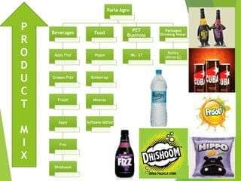
Email Ad Campaign 2 -
Lead Generation: Target Audience Definition: Clearly define the target audience for Parle Agro's products. Understand their demographics, interests, behavior, and pain points to create targeted marketing campaigns.
Online Presence: Enhance the company's online presence through a well-designed and user- friendly website. Optimize the website for search engines (SEO) to attract organic traffic.
Content Marketing: Develop engaging and informative content related to Parle Agro's products. This could include blog posts, videos, infographics, and social media content. Share this content on various platforms to reach potential customers.
Social Media Marketing: Utilize social media platforms to connect with the target audience directly. Engage with users, respond to their queries, and run targeted ad campaigns to drive traffic to the website.
Email Marketing: Implement an email marketing strategy to capture leads and nurture

Slide 33
ADVERTISING GOALS:
Brand Mindfulness: Increment brand mindfulness by contacting a more extensive crowd and guaranteeing that purchasers perceive and recollect Parle Agro's items and logo.
Item Send off Advancement: Effectively send off new items or flavors by making buzz and fervor through promoting efforts.
Increment Deals: Drive deals and income by advancing unique offers, limits, and restricted time bargains on Parle Agro's refreshments.
Teach Customers: Instruct buyers about the advantages of Parle Agro's natural product based refreshments, featuring their healthy benefit and remarkable selling focuses.

Slide 34
TARGET AUDIENCE:
Youngsters and Teens: Parle Agro's items, like Frooti and Appy, have major areas of strength for a to kids and teens because of their invigorating and fun nature. These drinks are much of the time well known decisions for youngsters and youthful grown-ups searching for scrumptious and advantageous rewards.
Youthful Grown-ups and Recent college grads: Parle Agro's refreshments are likewise preferred by youthful grown-ups and twenty to thirty year olds who partake in an assortment of drink choices. This segment is many times wellbeing cognizant and may pick natural product based refreshments as a better option in contrast to carbonated drinks.
Metropolitan Shoppers: Parle Agro's items have a critical presence in metropolitan regions, focusing on purchasers who carry on with occupied existences and look for in a hurry rewards.
Wellbeing Cognizant Shoppers: Wellbeing cognizant people searching for refreshments with regular natural product fixings and no additional additives might be attracted to Parle Agro's items.
Guardians and Families: Guardians might pick Parle Agro's refreshments for their kids, particularly as a component of lunchbox choices or family trips.

Slide 35
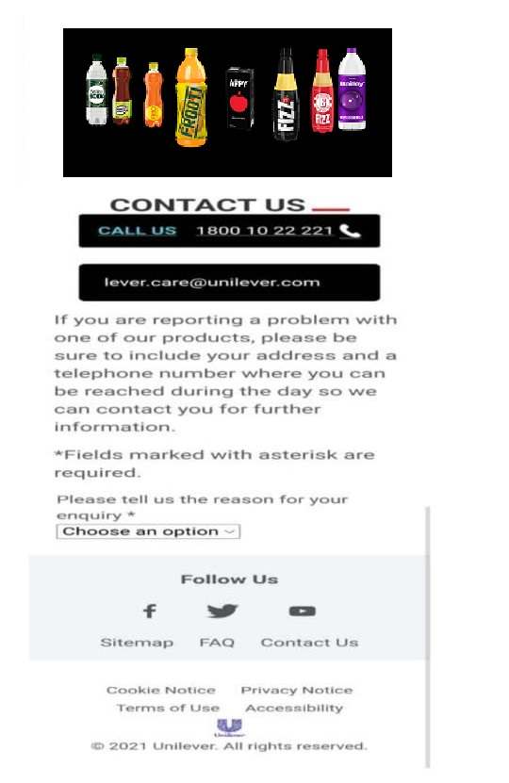
Email Ad Campaign 1 - Brand Awareness
(insert emailer image)

Slide 36

Email Ad Campaign 2 - Lead Generation
(insert emailer image)
Parle agro

Slide 37
Part 4: Content Creation and Curation (Post creations, Designs/Video
Editing, Ad Campaigns over Social Media and Email Ideation and Creation)
Reflect on the content creation and curation process, discussing the challenges faced and lessons learned.
Challenges Faced:
Grasping the Crowd: One of the essential difficulties in satisfied creation is really figuring out the interest group.
Consistency and Brand Voice: Keeping up with consistency in satisfied creation and guaranteeing it lines up with the brand's voice is fundamental for building memorability and devotion.
Quality versus Amount: Finding some kind of harmony between delivering excellent substance and keeping a predictable posting timetable can be troublesome.
Estimating Content Execution: Investigating the outcome of their substance is vital to comprehend what works and what doesn't.
Adjusting to Stage Contrasts: Every virtual entertainment stage and promoting channel has its own extraordinary attributes and client conduct.

Slide 38
Lessons Learned:
Information Driven Approach: Use information and examination to come to informed conclusions about happy creation and curation. Routinely dissect crowd bits of knowledge and content execution to refine their systems.
Nimbleness and Adaptability: Remain dexterous in answering changing business sector patterns and customer inclinations. Adaptability permits them to adjust rapidly and stay important.
Legitimacy and Straightforwardness: Purchasers value real and straightforward correspondence. Speaking the truth about items and their advantages can construct entrust with the crowd.
Narrating: Recount the brand, items, or encounters to draw in and associate genuinely with the crowd.
Drawing in with the Local area: Draw in with the crowd through remarks, messages, and web-based entertainment communications. Building a local area around their brands can make brand promoters and encourage faithfulness.
Joint efforts and Powerhouses: Teaming up with forces to be reckoned with and different brands can extend their compass and open their substance to new crowds.

